Slide 1
Crossing Cultures – Redeeming Mankind
Session 1: Foundational Cultural Considerations
Marvin Newell, DMiss

Slide 2
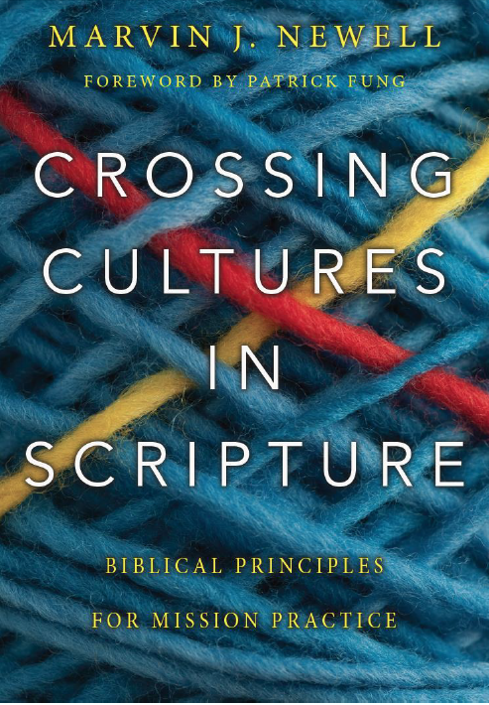

Slide 3

First & Final Authority

Slide 4

Crossing Cultures in Scripture
The Bible is a portrayer of cultures: it depicts and describes how communities and societies have lived out their beliefs, values, and customs.
The Bible is a sculptor of cultures: it helps shape and influence numerous cultures for the better found throughout the Bible.
The Bible is an appraiser of cultures: it’s supra-cultural values are meant to be the accepted moral standard for all cultures found everywhere through all of time.

Slide 5
Definition of Culture
Culture is the distinctive beliefs, values and customs of a particular group of people that determines how they think, feel, and behave.
Intertwining these three components comprises a people’s worldview

Slide 6
The Dimensions of Culture
Beliefs (think)
D
E
C
I
S
I
O
N
S
Experiences
World View
Values (feel)
Experiences
Customs (behave)
Adapted from Paul Hiebert

Slide 7


Culture’s Functions
Culture functions as both a road map & the road signs

Slide 8
Cultures encountered in Scripture
Hebrew, Chaldean, Egyptian, Ethiopian, Hittite, Midian, Mesopotamian, Syrian, Assyrian, Philistine, Canaanite, Moabite, Babylonian, Persian, Greek, Roman

Slide 9
Some of those who had X-C encounters
  Abraham
  Sarah
  Lot
  Jacob
  Joseph
  Moses
  Rahab
  Joshua
  Samson
Ruth
David
Solomon
Elijah
Ezekiel
Daniel
Jonah
Nehemiah
Esther
Jesus
John
Luke
Philip
Peter
Paul
Silas
Barnabas
Timothy
John Mark

Slide 10
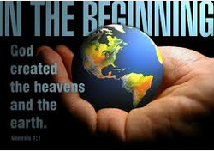
Eden: The Beginning of Human Culture Genesis 1

Slide 11
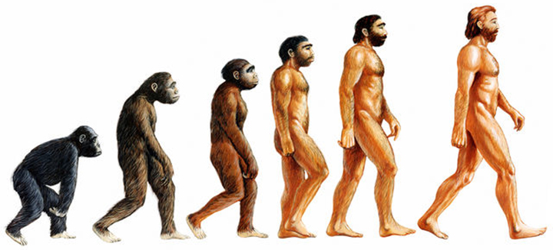
The Beginning of Human Culture: Secular - Humanism
Darwinian Delusion

Slide 12
Christian anthropologist:
William Smalley: nothing mentioned
Paul Hiebert: no attempt to determine origin of human culture
Charles Kraft: “Neither anthropology nor theology can speak conclusively about when culture began.” Christianity in Culture, page 103

Slide 13

Biblical Perspective: Created in God’s Image

Slide 14
Genesis 1: 26-27
Then God said, “Let us make man in our image, after our likeness. And let them have dominion over the fish of the sea and over the birds of the heavens and over the livestock and over all the earth and over every creeping thing that creeps on the earth.” So God created man in his image, in the image of God he created him; male and female he created him.

Slide 15

The Beginning of Human Culture Genesis 1:26-27
The Plurality of God & “Capacity”
From Capacity to Actuality
Culture at its Best
The Deterioration of Culture
The Redeeming of Culture

Slide 16
Implications of God as the Bestower of culture upon humans
Human culture is not intrinsically evil. God endowed humans with culture so that they might enjoy relationship. Although cultures have become corrupt, culture in and of itself is necessary for human interaction.
All humans as descendants of a common father makes possible the three tiers of culture:
“I am like nobody else” (individual culture)
“I am like somebodies else” (community culture)
“I am like everybody else” (universal culture)

Slide 17
Implications continued…
There is no rational basis for devaluing peoples of other cultures. They are fully human just like you.
There is no evaluative basis for considering other cultures as inferior and sub-human.
There is no moral basis for abusing others of different cultures, exhibiting a posture of superiority and ethnocentrism. We are all created equal and equally endowed with culture.
There is no legal basis for the justification of genocide, the wholesale slaughter of culturally different fellow humans, based on a position of strength and opportunity.

Slide 18
The Tower of Babel: The Beginning of Cultural Diversity
Genesis 11
⁶ And the Lord said, “Behold, they are one people, and they have all one language, and this is only the beginning of what they will do. And nothing that they propose to do will now be impossible for them. ⁷ Come, let us go down and there confuse their language, so that they may not understand one another's speech.” ⁸ So the Lord dispersed them from there over the face of all the earth, and they left off building the city. ⁹ Therefore its name was called Babel, because there the Lord confused the language of all the earth. And from there the Lord dispersed them over the face of all the earth.

Slide 19
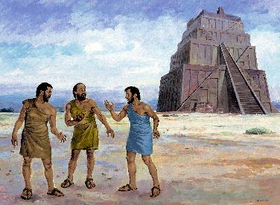
The Tower of Babel: The Beginning of Cultural Diversity
Genesis 11
Oneness and Unity
Abuse of Unity
Gracious Judgment
Culture follows language
Appreciation of cultural
diversity
Human Dispersion

Slide 20
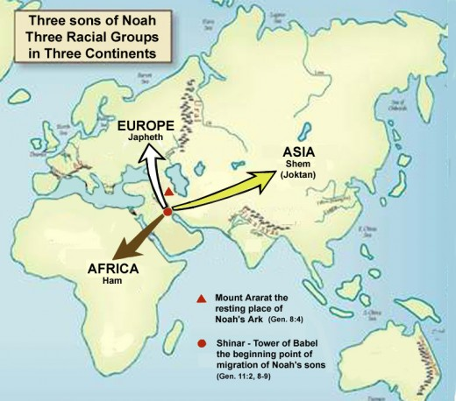

Slide 21
In light of this chapter, discuss the following statement from the Cape Town Commitment
“Ethnic diversity is the gift of God in creation and will be preserved in the new creation, when it will be liberated from our fallen divisions and rivalry. Our love for all peoples reflects God’s promise to bless all nations on earth and God’s mission to create for himself a people drawn from every tribe, language, nation and people. We must love all that God has chosen to bless, which includes all cultures. Historically, Christian mission, though flawed by destructive failures, has been instrumental in protecting and preserving indigenous cultures and their languages. Godly love, however, also includes critical discernment, for all cultures show not only positive evidence of the image of God in human lives, but also the negative fingerprints of Satan and sin.”

Slide 22
Abraham: Father of Blessing for All Cultures Genesis 12:1-3
1 Now the Lord said to Abram, “Go from your country and your kindred and your father’s house to the land that I will show you. 2 And I will make of you a great nation, and I will bless you and make your name great, so that you will be a blessing. 3 I will bless those who bless you, and him who dishonors you I will curse, and in you all the families of the earth shall be blessed.”

Slide 23
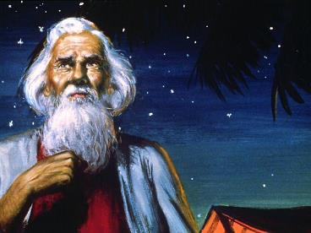
Abraham: Father of Blessing for All Cultures Genesis 12:1-3
God’s global rescue plan
Importance seen by the repetition of the promise
  To Abraham (3X)
  To Isaac
  To Jacob

Slide 24
The Blessing Passages
To Abraham:
“I will bless those who bless you, and him who dishonors you I will curse, and in you all the families of the earth shall be blessed.” (Genesis 12:3)
“The Lord said, ‘Shall I hide from Abraham what I am about to do, seeing that Abraham shall surely become a great and mighty nation, and all the nations of the earth shall be blessed in him?” (Genesis 18:17-18)
“and in your offspring shall all the nations of the earth be blessed, because you have obeyed my voice. (Genesis 22:18)
To Isaac:
“I will multiply your offspring as the stars of heaven and will give to your offspring all these lands. And in your offspring all the nations of the earth shall be blessed, because Abraham obeyed my voice and kept my charge, my commandments, my statutes, and my laws.” (Genesis 26:4)
To Jacob:
“Your offspring shall be like the dust of the earth, and you shall spread abroad to the west and to the east and to the north and to the south, and in you and your offspring shall all the families of the earth be blessed.” (Genesis 28:14)

Slide 25
Abraham: Father of Blessing for All Cultures Genesis 12:1-3
God’s global rescue plan
Importance seen by the repetition of the promise
  To Abraham (3X)
  To Isaac
  To Jacob
Universality shown by the
word “families”
Universality shown by the phrase
“of the earth”
The Blessing

Slide 26
Jesus is the “blessing”
“so that in Christ Jesus the blessing of Abraham might come to the Gentiles, so that we might receive the promised Spirit through faith.” (Gal. 3:14)

Slide 27
Cultural Practices the Gospel Challenges
suttee (wife burning) infanticide foot binding
body mutilation abortion human sacrifice
animal sacrifice voodoo black magic
white magic evil eye polygamy
polyandry wife swapping homosexuality religious prostitution child brides female circumcision
honor killing punishment by amputation
female suppression facial tattoos (to ward off evil spirits)
slavery unbridled consumerism
creation abuse exploitation incest
genocide co-habitation forced child labor

Slide 28
Abraham: Father of Blessing for All Cultures Genesis 12:1-3
God’s global rescue plan
Importance seen by the repetition of the promise
  To Abraham (3X)
  To Isaac
  To Jacob
Universality shown by the
word “families”
Universality shown by the phrase
“of the earth”
The Blessing
Abraham’s honored role

Slide 29
Missiological Implications of Abraham Being the Father of Blessing for all Cultures:
The “hope of all nations” (i.e. Jesus) theme given through Abraham and his descendants, threading itself through the entirety of Scripture and throughout the church age, means that no people group should be excluded from that hope, no matter how hopeless they appear to be.
No group of people should be considered unworthy of our efforts to receive the blessing of Abraham, no matter how distant, remote, or impenetrable they are.

Slide 30
Missiological implications cont…
The spiritual blessings intended for all mankind that are found in Jesus, are designed to be enjoyed by every cultural group on the face of the earth, no matter how depraved or hideous their conduct.
Abraham, as God’s chosen one, is to be honored by all peoples because of that special calling and his subsequent faith response, no matter how anti-Semitic they are.

Slide 31
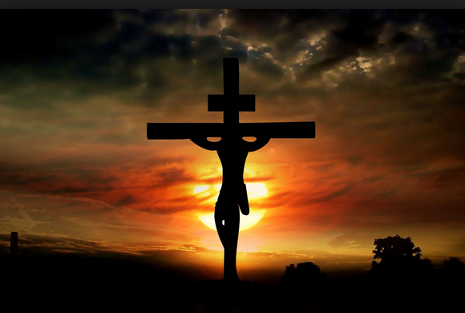
Redeeming Mankind
God’s global intent is to redeem individuals, and by extension, bring blessing to every cultural expression found on earth.
Individuals and entire
cultures experience
biblically adjusted
beliefs, values and
customs.

Slide 32
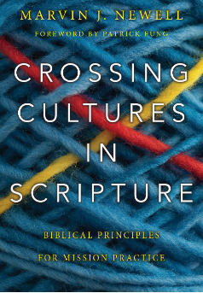
Missio Nexus Web Workshop
Questions?
Session 2 next week:
Crossing Cultures in the
Old Testament
MNewell@missionexus.org

